Slide 1
Chemical Process Industries
University of Diyala Chemical Engineering Department
Lecture (7)
د. أديبة النعيمي

Slide 2
Cement Industry
Cement: is a material with adhesive and cohesive properties which make it capable of bonding minerals fragments into a compact whole. For constructional purposes, the meaning of the term "cement" is restricted to the bonding materials used with stones, sand, bricks, building stones, etc

Slide 3
Raw material:
1) primary : which form > 85% clinker.
2) secondary: which form < 15% clinker.
This is required to modify Si, Fe, Al %.
3) tertiary: are used for some purpose other than clinker formation , e.g.
a) for reducing water content of slurry.
b) increasing output of grinding equipment or decreasing power.
c) output yield.
d) fluxes for facilitating clinker production.

Slide 4
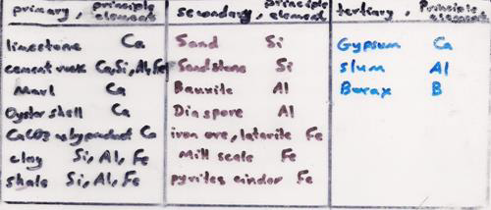

Slide 5
Concrete is made by portland cement, water and aggregates. Portland cement is a hydraulic cement that hardens in water to form a water-resistant compound. The hydration products act as binder to hold the aggregates together to form concrete

Slide 6
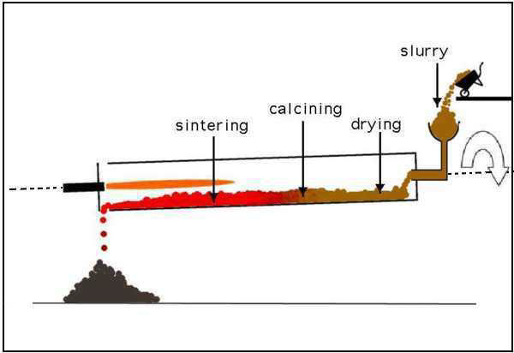

Slide 7
Classification of Cement :
Classification of Cement :
1) Normal setting or ordinary cement- called Portland cement.
2) Rapid-hardening cement: this is a high early-strength (H.E.S) cement, the (H.E.S) is due to:
a) finer grinding
b) burning at higher temperature, and
c) increased lime content in the composition.

Slide 8
3)Quick setting cement: the setting action starts within 5 min after addition of water and become stane hard in less than 0.5 hr.
4) Low heat cement: the heat of hydration is reduced . It cotain less lime than ordinary cement.
5) Blast furnace cement: 65% of blast furnace slag ( waste product, contain Al2O3& SiO2& CaO) is mixed with 35% clinker to make very strong and durable cement. .

Slide 9
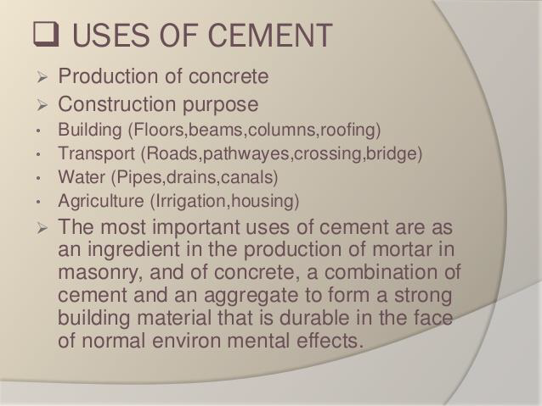

Slide 10
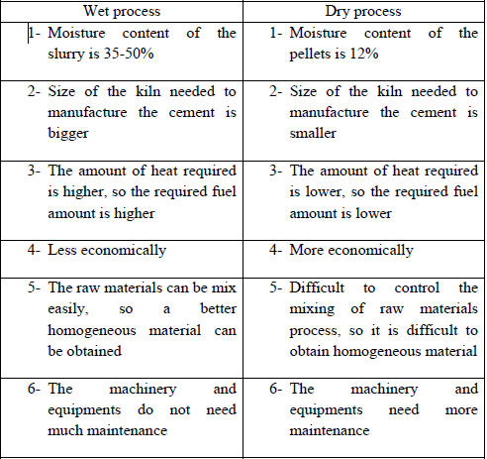
Comparison between wet and dry process:

